Slide 1
MATLAB ASSIGNMENT
GROUP B MEMBERS

Slide 2
MEMBERS OF GROUP B.
NAME | REGISTRATION NUMBER | PROGRAM OF STUDY
ACHOM PEACE | BU/UP/2024/4811 | WAR
ALINDA MASIKA ROLPHINE | BU/UP/2024/ | APE
MAATE PHILEMON | BU/UP/2024/ | AMI
ADUPA GEORGE RICHARD | BU/UP/2024/ | WAR
ASIMO MARTHA | BU/UP/2024/ | MEB
AYEBALE ELIAS | BU/UP/2023/ | AMI
KOMUHANGI AGATHA | BU/UP/2024/3735 | AMI
KATUNGUKA EMMANUEL | BU/UP/2024/1030 | WAR
KAKULU ALFRED | BU/UP/2024/ | MEB
TUSIIME JUNIOR YUSUF | BU/UP/2024/0848 | AMI
AMONGIN MARY LUCY | BU/UP/2024/1012 | WAR
NANTABA PATRICIA | BU/UG/2024/2601 | PTI
APUDA CECILIA LINDI | BU/UP/2024/3248 | WAR
AMONGIN MIRIAM | BU/UP/2024/4448 | WAR
KAGODA ENOCK | BU/UP/2024/3733 | WAR3
KAKONYA GERALD | BU/UG/2024/2603 | PTI
RUBANGAKENE OYET GERALD | BU/UP/2024/4452 | WAR
SIKORIA AGGREY JOSHUA | BU/UP/2024/1070 | WAR
APIO LAURA OLLA | BU/UP/2024/1015 | WAR

Slide 3
COMPUTER PROGRAMING. (MATLAB)
Is a high level programing language and interactive environment designed or numerical computation, data analysis and visualisation.

Slide 4
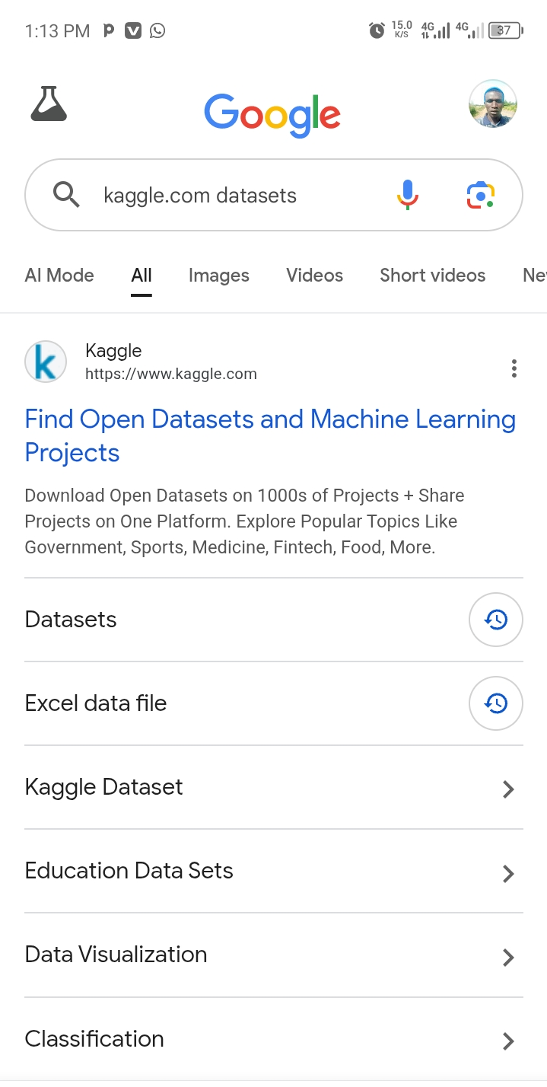
QUESTION 1 Kaggle.com website from goggle.

Slide 5
EXTRACTING TABLE FROM DATASET.
Athletetable=readtable("athlete_events.xlsx",'ReadVariableNames',true);
disp(Athletetable);
Athlete2=table2struct(Athletetable)
writetable(Athlete3,'athlete_events.xlsx','Sheet','SET1');

Slide 6
EXTRACTING YEARLY DATA.
Athlete2000=Athletetable(Athletetable.Year==2000,:);
Athlete2002=Athletetable(Athletetable.Year==2002,:);
Athlete2004=Athletetable(Athletetable.Year==2004,:);
Athlete2006=Athletetable(Athletetable.Year==2006,:);
Athlete2008=Athletetable(Athletetable.Year==2008,:);
Athlete2010=Athletetable(Athletetable.Year==2010,:);
Athlete2012=Athletetable(Athletetable.Year==2012,:);
Athlete2014=Athletetable(Athletetable.Year==2014,:);
Athlete2016=Athletetable(Athletetable.Year==2016,:);

Slide 7
CONVERTING YEARLY DATA FROM TABLE TO STRCTURAL ARRAYS
AthleteA00=table2struct(Athlete2000);
AthleteA02=table2struct(Athlete2002);
AthleteA04=table2struct(Athlete2004);
AthleteA06=table2struct(Athlete2006);
AthleteA08=table2struct(Athlete2008);
AthleteA10=table2struct(Athlete2010);
AthleteA12=table2struct(Athlete2012);
AthleteA14=table2struct(Athlete2014);
AthleteA16=table2struct(Athlete2016);

Slide 8
FROM STRUCTURAL ARRAYS TO TABLE
AthleteT00=struct2table(AthleteA00);
AthleteT02=struct2table(AthleteA02);
AthleteT04=struct2table(AthleteA04);
AthleteT06=struct2table(AthleteA06);
AthleteT08=struct2table(AthleteA08);
AthleteT10=struct2table(AthleteA10);
AthleteT12=struct2table(AthleteA12);
AthleteT14=struct2table(AthleteA14);
AthleteT16=struct2table(AthleteA16);

Slide 9
INSERTING YEARLY DAET. TA TO EXCEL SHE
writetable(AthleteT00,'athlete_events.xlsx','Sheet','2000','writevariable', true);
writetable(AthleteT02,'athlete_events.xlsx','Sheet','2002','writevariable', true);
writetable(AthleteT04,'athlete_events.xlsx','Sheet','2004','writevariable', true);
writetable(AthleteT06,'athlete_events.xlsx','Sheet','2006','writevariable', true);
writetable(AthleteT08,'athlete_events.xlsx','Sheet','2008','writevariable', true);
writetable(AthleteT10,'athlete_events.xlsx','Sheet','2010','writevariable', true);
writetable(AthleteT12,'athlete_events.xlsx','Sheet','2012','writevariable', true);
writetable(AthleteT14,'athlete_events.xlsx','Sheet','2014','writevariable', true);
writetable(AthleteT16,'athlete_events.xlsx','Sheet','2016','writevariable', true);

Slide 10
QUESTION 2. THE CODES WERE RUN TO SORT EACH DATA.
name = ["Rubangakene Gerald Oyet"; "Alinda Masika Rolphine"; "Achom Peace"; "Maate Phillemon"; "Adupa George Richard"; "Asimo Martha"; "Ayebale Ellias"; "Komuhangi Agatha"; "Katunguka Emmanuel"; "Kakulu Alfred"; "Tusiime Junior Yusuf"; "Amongin Mary Lucy"; "Nantaba Patricia"; "Apuda Lindi Cecilia"; "Amongin Mirriam"; "Kagoda Enock"; "Kakonya Gerald"; "Sikoria Agrrey Joshua"];
age = [23; 22; 25; 22; 23; 25; 16; 20; 25; 22; 23; 22; 24; 21; 21; 26; 23; 22];
tribe = ["Acholi"; "Mukonzo"; "Itesot"; "Mukonzo"; "Itesot"; "Samia"; "Mukiga"; "Munyakole"; "Munyankole"; "Munyoro"; "Itesot"; "Muganda"; "Itesot"; "Itesot"; "Muganda"; "Mukonzo"; "Mukonzo"; "Sebiny"];
home_district = ["Gulu"; "Kasese"; "Pallisa"; "Kampala"; "Lira"; "Kumi"; "Soroti"; "Rubanda"; "Mpigi"; "Ntungamo"; "Wakiso"; "Hoima"; "Ngora"; "Mukono"; "Kataki"; "Kumi"; "Kasese"; "Kabedamaido"];
interest = ["Bakery"; "Instruments"; "Business"; "Agriculture"; "Music"; "Travelling"; "Kaboozi"; "Singing"; "Travelling"; "Hand ball"; "Patriotism"; "Football"; "Volley ball"; "Crochet"; "Journalism"; "Cooking"; "Football"; "singing"];
course = ["WAR2"; "APE2"; "WAR2"; "AMI2"; "WAR2"; "MEB2"; "AMI2"; "AMI2"; "WAR2"; "MEB2"; "WAR2"; "MEB2"; "WAR2"; "WAR2"; "WAR2"; "WAR2"; "PTI"; "WAR2"];

Slide 11
village = ["Lacor"; "Ibanda"; "Gogonyo"; "Kyanduli"; "Omolokonyo"; "Agirigiro"; "Karengyere"; "Kalagala"; "Nabgingi"; "Acepet"; "Kityedo"; "Nyamongo"; "Mukono"; "Katakwi"; "Kamacha"; "Busitema"; "Maliba"; "Bundijo"];
religion = ["Born again"; "Anglican"; "Othodox"; "Catholic"; "Phanero"; "Islam"; "Pegan"; "Born again"; "Catholic"; "Islam"; "Phanero"; "Orthodox"; "Catholic"; "SDA"; "Born again"; "Catholic"; "SDA"; "Anglican"];
facial_representation = {imread("GERALD.jpg"); imread("ROLPHINE.jpg"); imread("PEACE.jpg"); imread("PHILLEMON.jpg"); imread("GEORGE.jpg"); imread("MARTHA.jpg"); imread("ELLIAS.jpg"); imread("AGATHA.jpg"); imread("EMMA.jpg");
imread("ALFRED.jpg"); imread("YUSUF.jpg"); imread("LUCY.jpg"); imread("PATRICIA.jpg"); imread("LINDI.jpg"); imread("MICOH.jpg"); imread("ENOCH.jpg"); imread("KAKONYA.jpg"); imread("AGGREY.jpg")};
GroupB=table(name,age,tribe,home_district,interest,course,village,religion,facial_representation);
save("Studentsdata","GroupB");
disp(GroupB);

Slide 12
Conclusion.
The assignment was successful since there was maximum cooperation among group B members.
REFERENCES
1.Matlab programming or engineers. By stephen J. CHAPMAN.
2.Introduction programming for engineers .By WILLIAM J.PALM III.
3.Essentials of matlab programming. BY STEPHEN J. CHAPMAN.

